Slide 1
Q.1. For a given op-amp, CMRR = 10⁵ and differential gain A_{d} = 10⁵. Determine the common-mode gain A_{cm} of the op-amp.

Slide 2

Solution: Given CMRR = 10⁵, A_{d} = 10⁵
$$CMRR=\frac{A_{d}}{A_{cm}}$$
therefore, A_{cm} = 10⁵/10⁵ = 1

Slide 3
For a given op-amp, the common mode rejection ration (CMRR) is given as
A_{cm}/A_{d}
A_{d}/A_{cm}
A_{cm} + A_{d}
A_{d} - A_{cm}

Slide 4
Q.2. For a given op-amp, common-mode gain A_{cm} = 0.5 and differential gain A_{d} = 10⁵. Determine the common-mode rejection ration (CMRR).

Slide 5
Answer: 2 x 10⁵

Slide 6
Q.3. The output voltage of a certain op-amp circuit changes by 20 V in 4 µs. What is its slew rate?

Slide 7

Solution: Given dV_{o} = 20 V, dt = 4 µs
$$Slew Rate=\frac{{dV}_{o}}{dt}$$
therefore, Slew Rate = 20/4 = 5 V/µs

Slide 8
For a given op-amp, the slew rate is given as
dt/dV_{o}
dt + dV_{o}
dV_{o} + dt
dV_{o}/dt

Slide 9
Q.4. The slew rate of a certain op-amp circuit is 4 V/µs. What is the change in output voltage for this slew rate if change in output voltage occurs in 4 µs.

Slide 10
Answer: 16 V

Slide 11
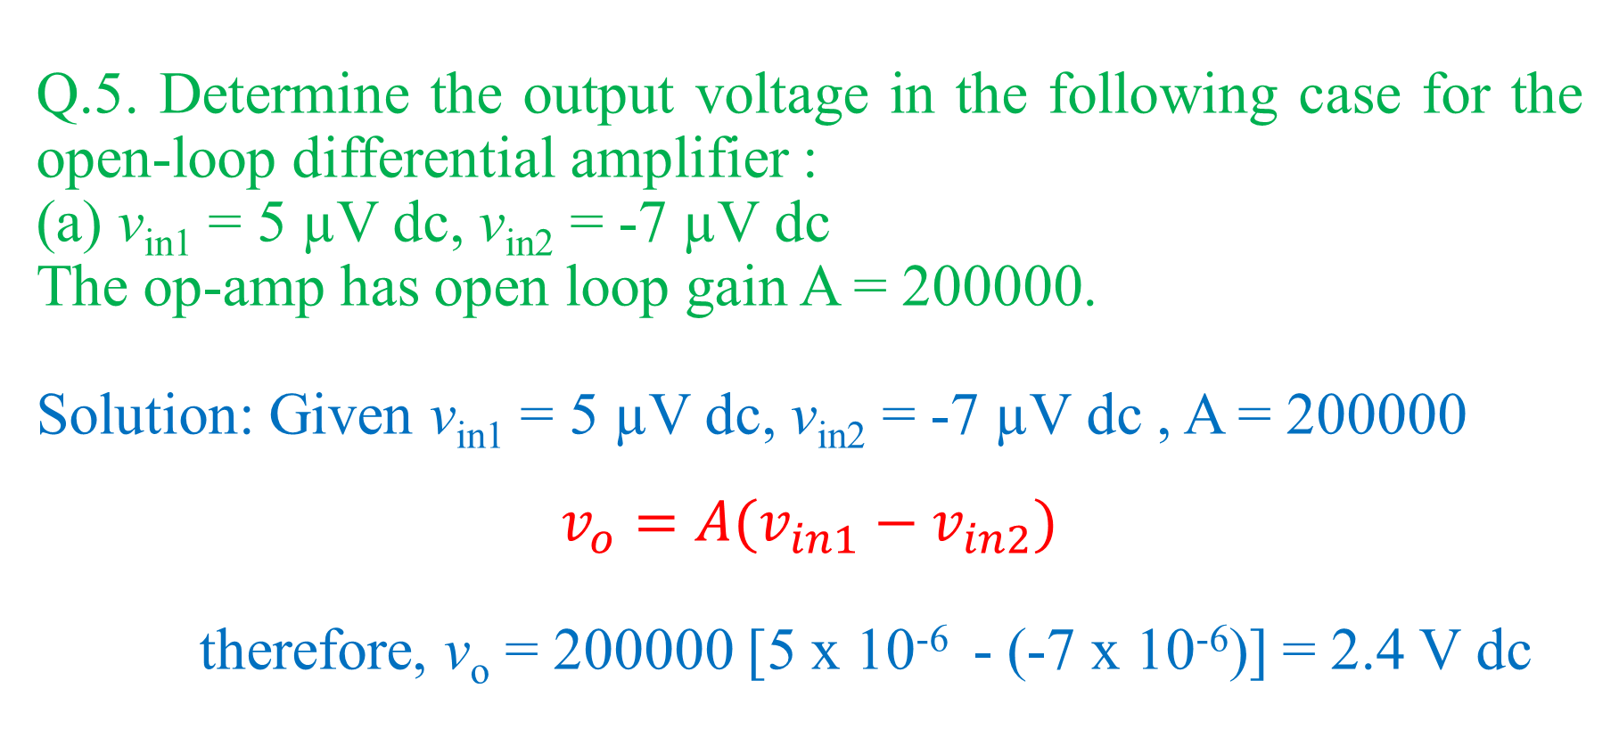
Q.5. Determine the output voltage in the following case for the open-loop differential amplifier :
(a) v_{in1} = 5 µV dc, v_{in2} = -7 µV dc
The op-amp has open loop gain A = 200000.
Solution: Given v_{in1} = 5 µV dc, v_{in2} = -7 µV dc , A = 200000
$$v_{o}=A(v_{in1}−v_{in2})$$
therefore, v_{o} = 200000 [5 x 10⁻⁶ - (-7 x 10⁻⁶)] = 2.4 V dc

Slide 12
Q.6. Determine the output voltage in the following case for the open-loop differential amplifier :
(a) v_{in1} = 10 mV , v_{in2} = 20 mV
The op-amp has open loop gain A = 200000.

Slide 13
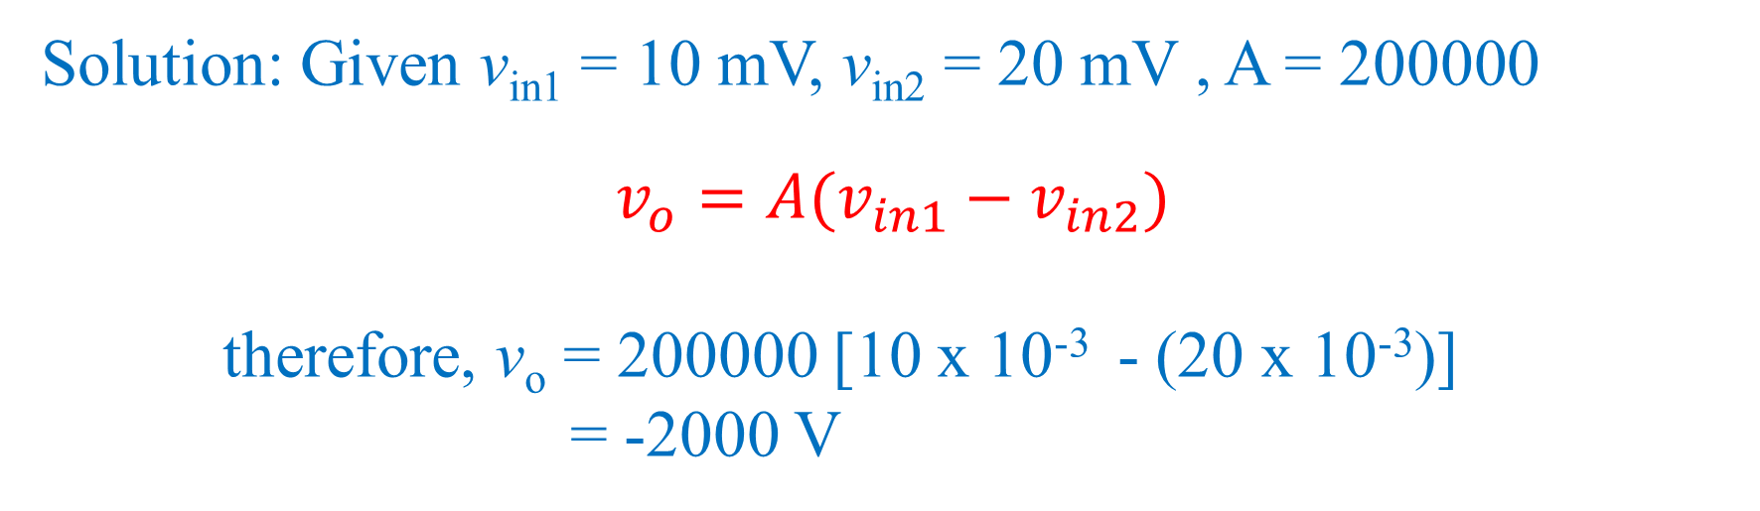
Solution: Given v_{in1} = 10 mV, v_{in2} = 20 mV , A = 200000
$$v_{o}=A(v_{in1}−v_{in2})$$
therefore, v_{o} = 200000 [10 x 10⁻³ - (20 x 10⁻³)]
= -2000 V

Slide 14
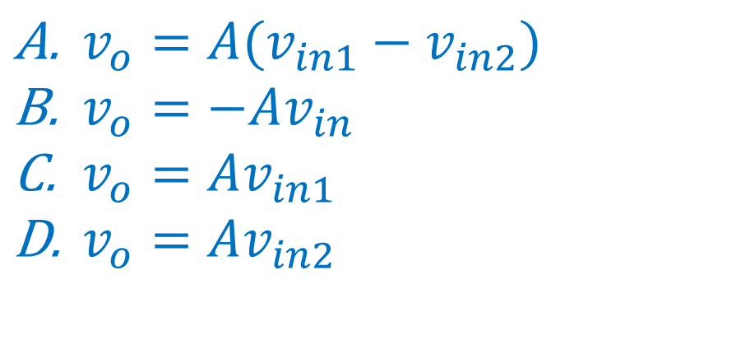
The output voltage of an op-amp connected in inverting amplifier configuration is given as
$v_{o}=A(v_{in1}−v_{in2})$
$v_{o}=−Av_{in}$
$v_{o}=Av_{in1}$
$v_{o}=Av_{in2}$

Slide 15
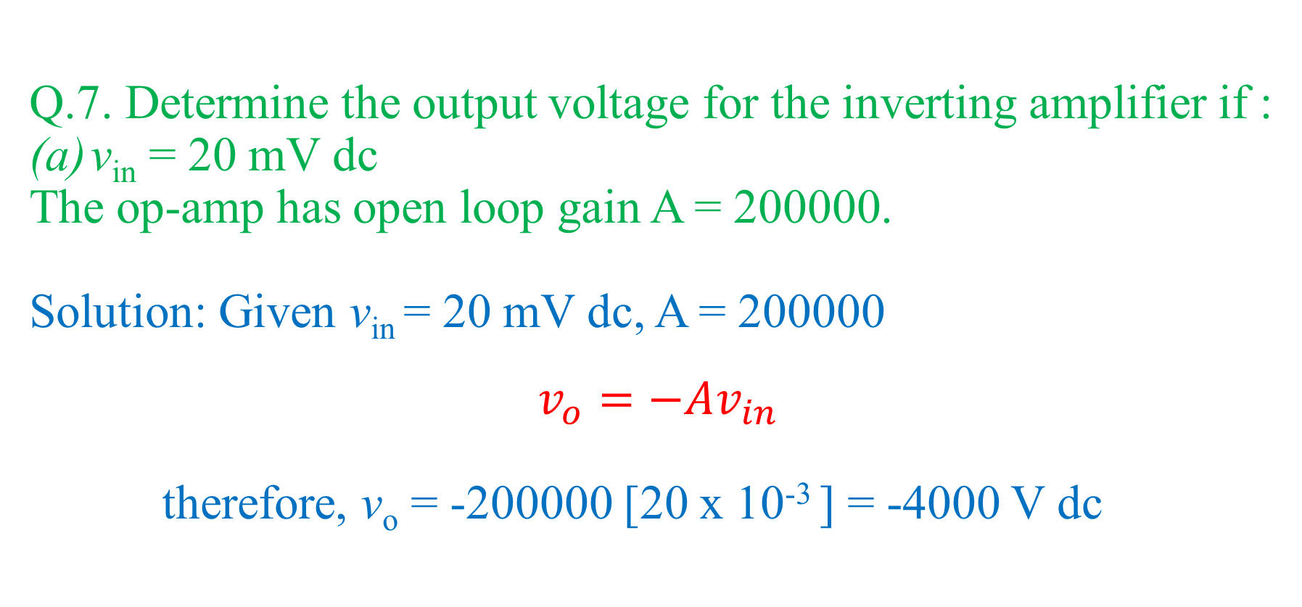
Q.7. Determine the output voltage for the inverting amplifier if :
v_{in} = 20 mV dc
The op-amp has open loop gain A = 200000.
Solution: Given v_{in} = 20 mV dc, A = 200000
$$v_{o}=−Av_{in}$$
therefore, v_{o} = -200000 [20 x 10⁻³ ] = -4000 V dc

Slide 16
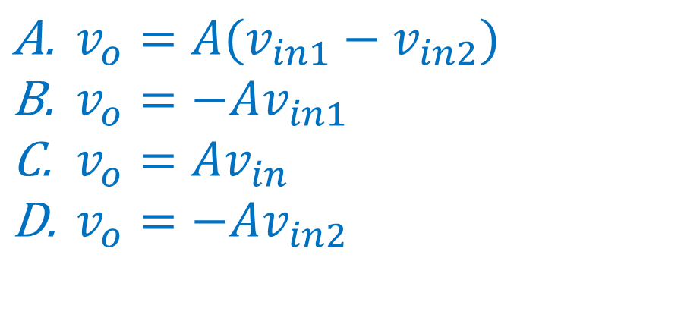
The output voltage of an op-amp working as non-inverting amplifier configuration is given as
$v_{o}=A(v_{in1}−v_{in2})$
$v_{o}=−Av_{in1}$
$v_{o}=Av_{in}$
$v_{o}=−Av_{in2}$

Slide 17
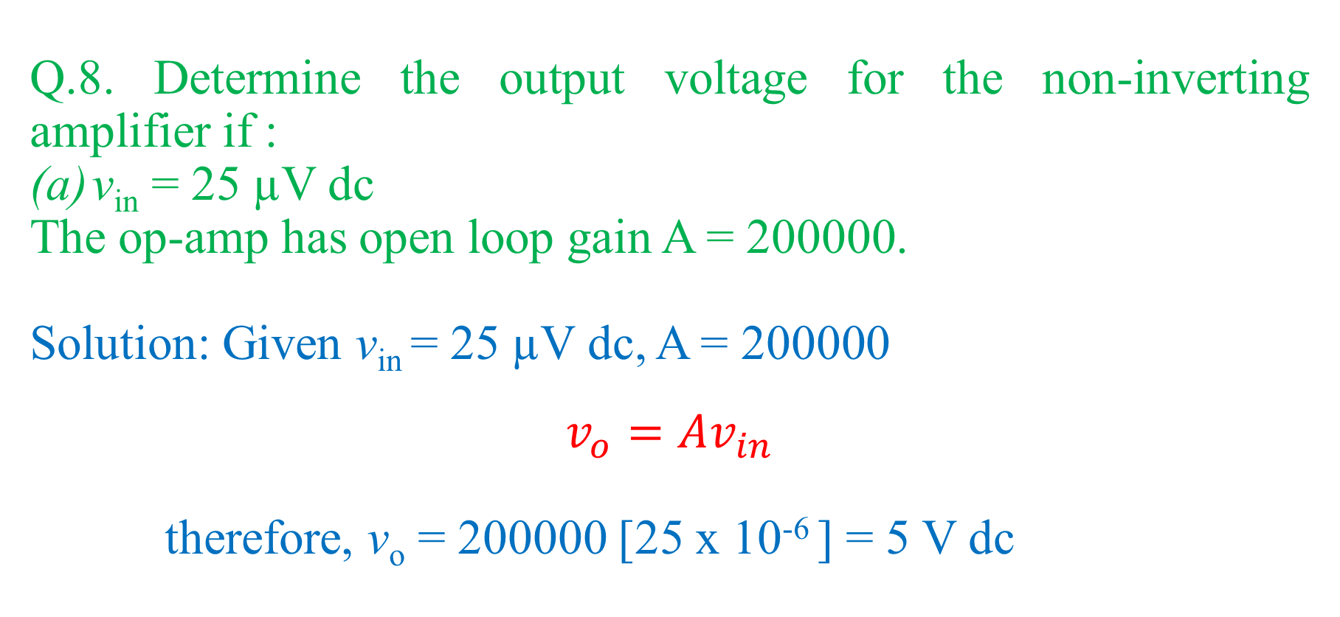
Q.8. Determine the output voltage for the non-inverting amplifier if :
v_{in} = 25 µV dc
The op-amp has open loop gain A = 200000.
Solution: Given v_{in} = 25 µV dc, A = 200000
$$v_{o}=Av_{in}$$
therefore, v_{o} = 200000 [25 x 10⁻⁶ ] = 5 V dc

Slide 18
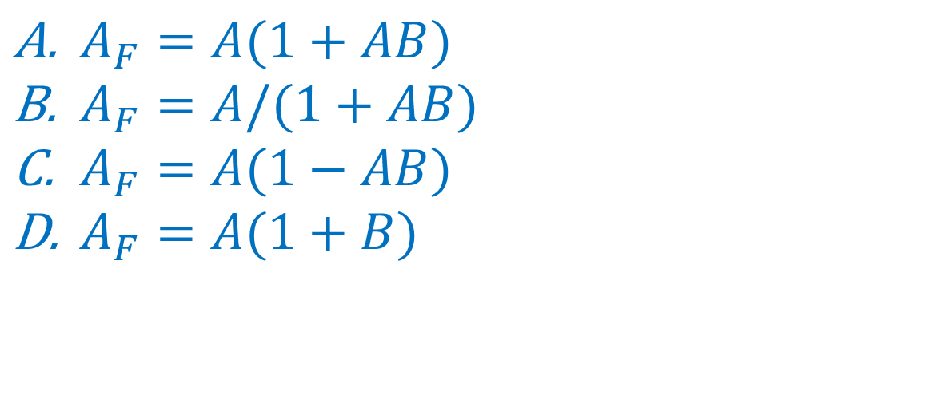
For an op-amp connected in non-inverting amplifier configuration with feedback, the closed loop gain is given as,
$A_{F}=A(1+AB)$
$A_{F}=A/(1+AB)$
$A_{F}=A(1−AB)$
$A_{F}=A(1+B)$

Slide 19
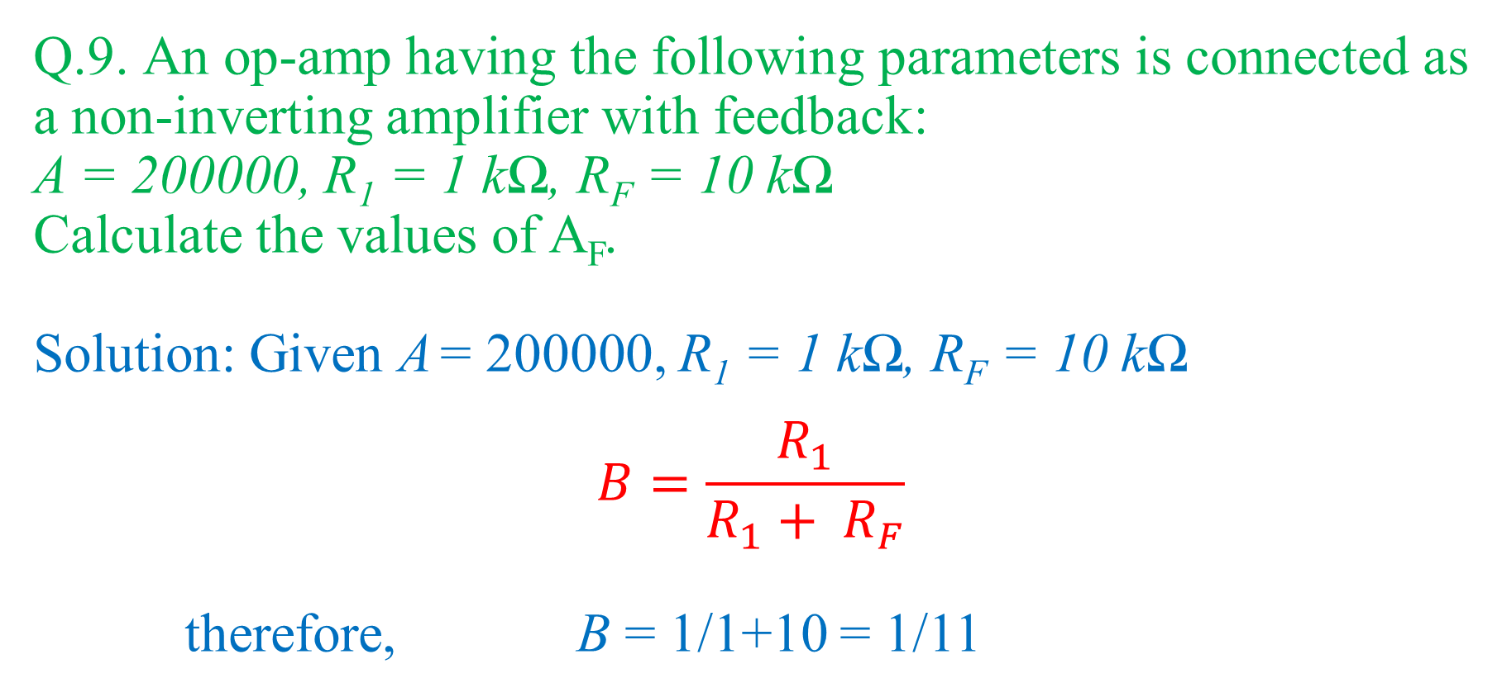
Q.9. An op-amp having the following parameters is connected as a non-inverting amplifier with feedback:
A = 200000, R₁ = 1 kΩ, R_{F} = 10 kΩ
Calculate the values of A_{F}.
Solution: Given A = 200000, R₁ = 1 kΩ, R_{F} = 10 kΩ
$$B=\frac{R_{1}}{R_{1}+ R_{F}}$$
therefore, B = 1/1+10 = 1/11

Slide 20
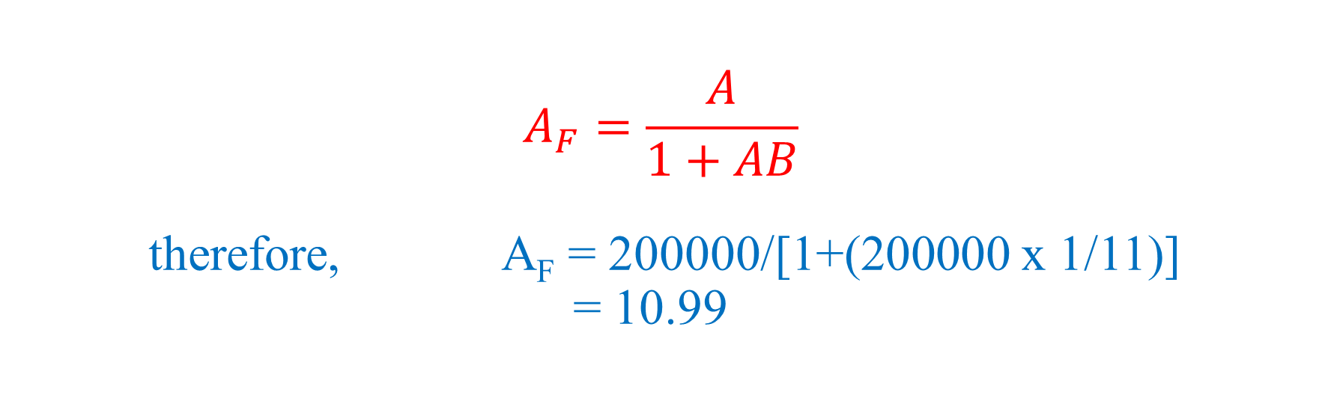
$$A_{F}=\frac{A}{1+AB}$$
therefore, A_{F} = 200000/[1+(200000 x 1/11)]
= 10.99

